Slide 1
Section 6.1
Area Between Two Curves

Slide 2
All graphics are attributed to:
Calculus,10/E by Howard Anton, Irl Bivens, and Stephen Davis Copyright © 2009 by John Wiley & Sons, Inc. All rights reserved.

Slide 3
Introduction
In the last chapter, the definite integral was introduced as the limit of Riemann sums and we used them to find area:
However, Riemann sums and definite integrals have applications that extend far beyond the area problem.
In this chapter, we will use Riemann sums and definite integrals to find volume and surface area of a solid, length of a plane curve, work done by a force, etc.
While these problems sound different, the calculations we will use will all follow a nearly identical procedure.

Slide 4
A Review of Riemann Sums
The distance between a and b is b-a.
Since we divided that distance into n subintervals, each is :
In each subinterval, draw a rectangle whose height is the value of the function f(x) at an arbitrarily selected point in the subinterval (a.k.a. x_{k}*) which gives f(x_{k}*).
Since the area of each rectangle is base * height, we get the formula you see on the right for each rectangle:
Area=
b*h = x * f(x_{k}*) = f(x_{k}*) x .

Slide 5
Review of Riemann Sums - continued
Remember, that was the area for each rectangle. We need to find the sum of the areas of all of the rectangles between a and b which is why we use sigma notation.
As we discussed in a previous section, the area estimate is more accurate with the more number of rectangles used. Therefore, we will let n approach infinity.

Slide 6
Area Between y = f(x) and y = g(x)
To find the area between two curves, we will divide the interval [a,b] into n subintervals (like we did in section 5.4) which subdivides the area region into n strips (see diagram below).

Slide 7
Area Between y = f(x) and y = g(x) continued
To find the height of each rectangle, subtract the function output values f(x_{k}*) – g(x_{k}*). The base is .
Therefore, the area of each strip is base * height = * [f(x_{k}*) – g(x_{k}*)].
We do not want the area of one strip, we want the sum of the areas of all of the strips. That is why we need the sigma.
Also, we want the limit as the number of rectangles “n” increases to approach infinity, in order to get an accurate area.

Slide 8
NOTE: insert slide here discussing Riemann sums and how to relate to the integral

Slide 9
Assuming One Curve is Always Above the Other

Slide 10
Summary of Steps Involved

Slide 11
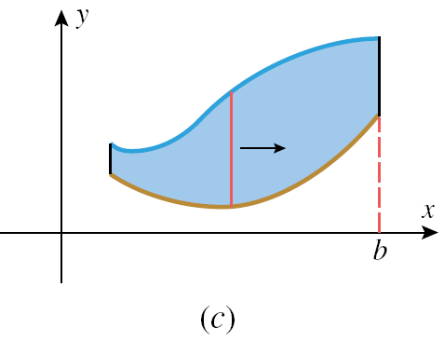
Picture of Steps Two and Three From Previous Slide:

Slide 12
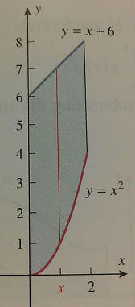
Straightforward Example

Slide 13
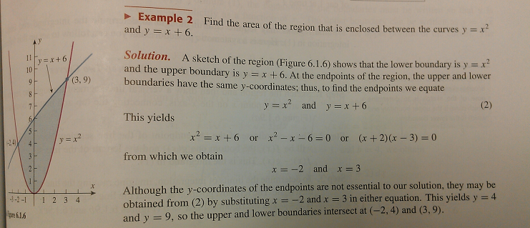
Sometimes, you will have to find the limits of integration by solving for the points of intersection first:
Then solve for the area as we did in the previous example:

Slide 14
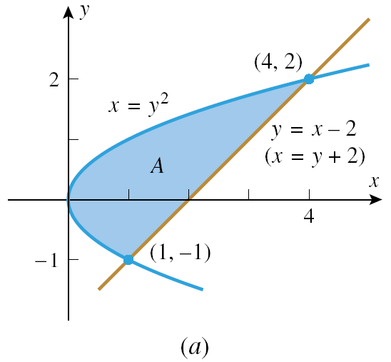
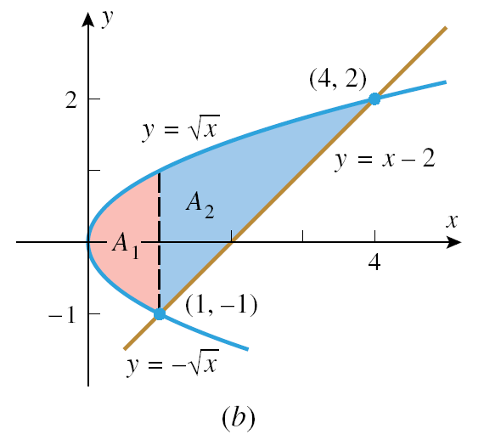
Inconsistent Boundaries
If you look at the area in figure (a), the upper and lower boundaries are not the same for the left portion of the graph as they are for the right portion.
On the left, the x = y² curve is the upper and lower boundary.
On the right, the x = y² curve is the upper boundary, but the line y = x – 2 is the lower boundary.
Therefore, in order to calculate the area using x as our variable, we must divide the region into two pieces, find the area of each, then add those areas to find the total area (see figure (b)).
See work on page 417 if interested.

Slide 15
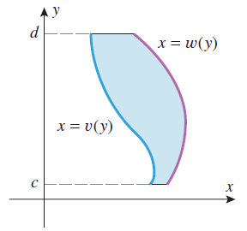
Reversing the Roles of x and y
Instead, we could reverse the roles of x and y to make it easier to find the area.
Solve for x in terms of y, find the lower and upper limits of integration in terms of y, and integrate with respect to y.

Slide 16
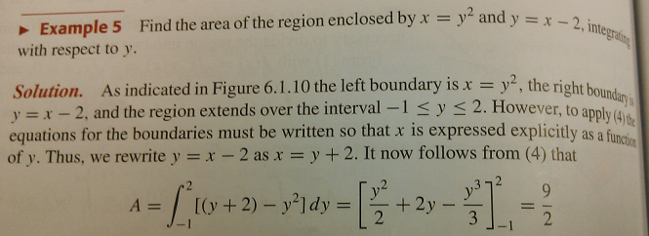
Reverse x and y to find the area on slide #13 instead of breaking into two sections.
You get exactly the same answer whether you break the area into two sections or if you reverse x and y.
This is a much easier and quicker calculation that we had to perform when we reversed x and y.
We avoided having to do two separate integrals and add our results.

Slide 17
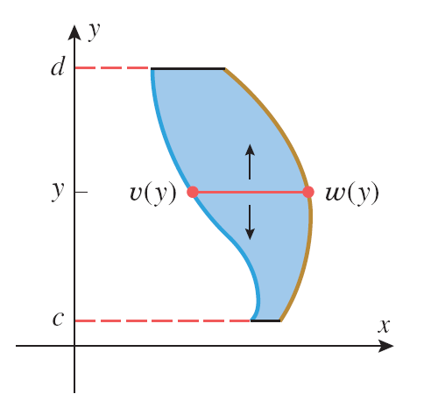
Formula and Picture for Reversing the Roles of x and y

Slide 18
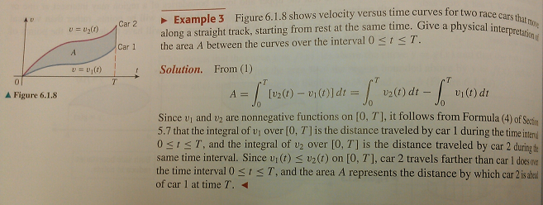
Application of Area Between Two Curves

Slide 19
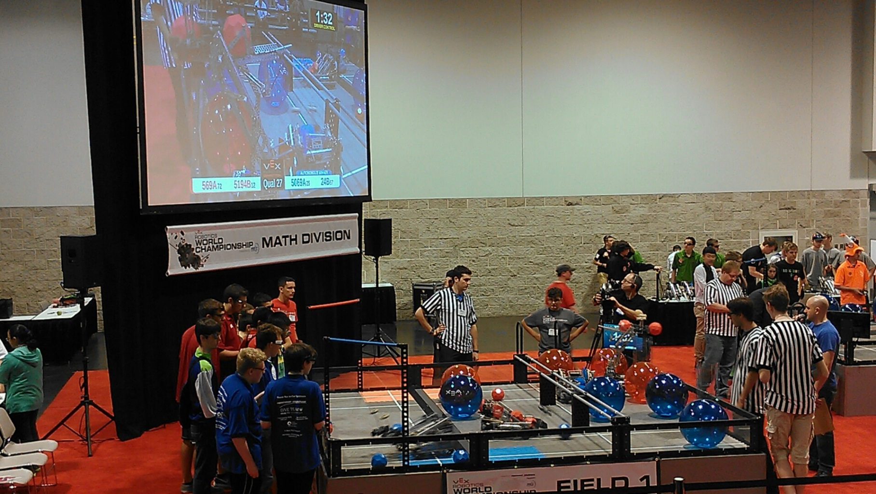
Robotics World Championships 2014

